Slide 1
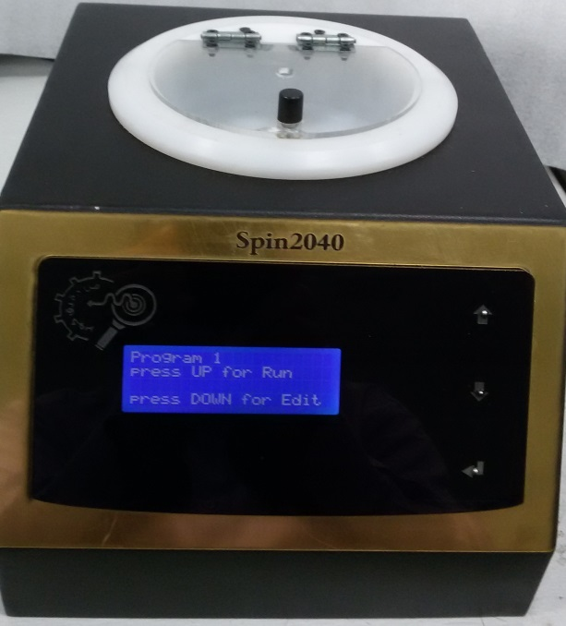
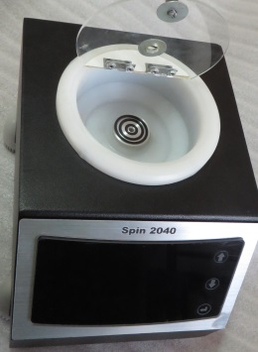
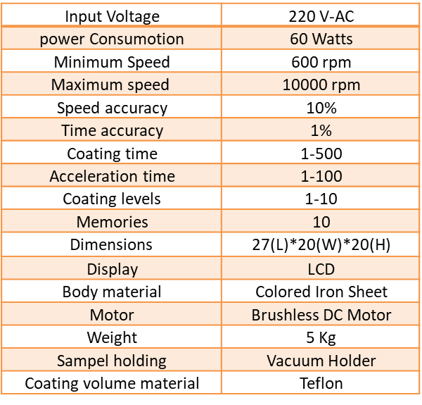
Spin Coater Model: SPIN 2040
Fan Daghigh Kovsar Company
Properties
220 V-AC | Input Voltage
60 Watts | power Consumotion
600 rpm | Minimum Speed
10000 rpm | Maximum speed
10% | Speed accuracy
1% | Time accuracy
1-500 | Coating time
1-100 | Acceleration time
1-10 | Coating levels
10 | Memories
27(L)*20(W)*20(H) | $$\text{Dimensions}$$
LCD | Display
Colored Iron Sheet | Body material
Brushless DC Motor | Motor
5 Kg | Weight
Vacuum Holder | Sampel holding
Teflon | Coating volume material
Applications
Physics labs
Chemical labs
Nano-physics labs
Nano-electronics
etc.
More
Spin coating is an easy and fast method for coating thin and homogenous films. In this method, the solution will coat smoothly and uniformly on the sample. The thickness could go down to nanometers by changing the viscosity of the solution and the spinning speed.
Address: No.11, Innovation and Commercialization Center, University of Kashan, Iran.
Phone& fax: +983155914014 mobile: +989133216246 Email: fandaghigh@gmail.com
:

