Slide 1
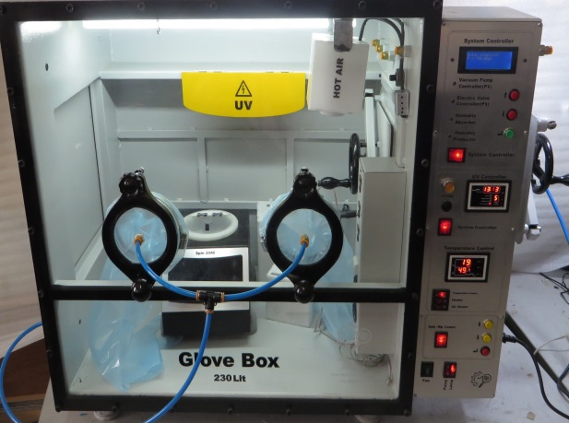
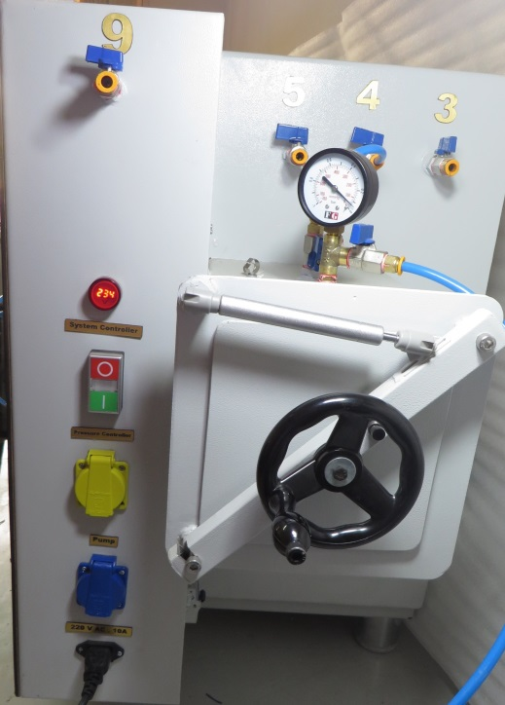
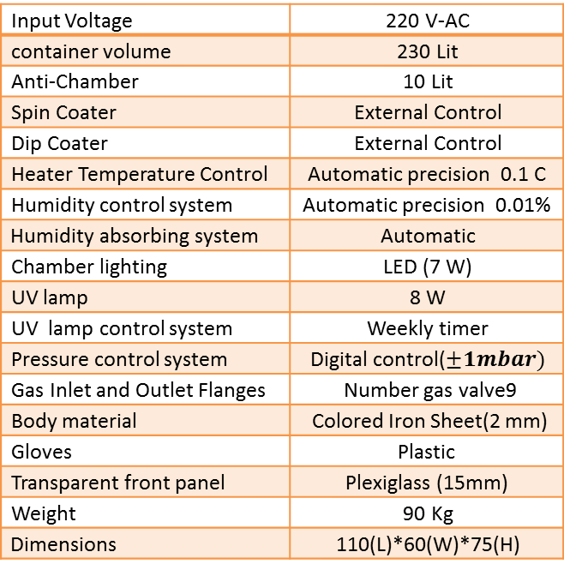
3000Glove Box Model: GBM
Fan Daghigh Kovsar Company
Properties
220 V-AC | Input Voltage
230 Lit | container volume
10 Lit | Anti-Chamber
External Control | Spin Coater
External Control | Dip Coater
Automatic precision 0.1 C | Heater Temperature Control
Automatic precision 0.01% | Humidity control system
Automatic | Humidity absorbing system
LED (7 W) | Chamber lighting
8 W | UV lamp
Weekly timer | UV lamp control system
Digital control($±1mbar)$ | Pressure control system
Number gas valve9 | Gas Inlet and Outlet Flanges
Colored Iron Sheet(2 mm) | Body material
Plastic | Gloves
Plexiglass (15mm) | Transparent front panel
90 Kg | Weight
110(L)*60(W)*75(H) | $$\text{Dimensions}$$
Applications
Physics labs
Chemical labs
Nano-physics labs
Nano-electronics
etc.
More
Glovbox is an isolated enclosure that allows researchers to conduct experiments in controlled environments including air pressure, temperature, humidity and oxygen content.
Address: No.11, Innovation and Commercialization Center, University of Kashan, Iran.
Phone& fax: +983155914014 mobile: +989133216246 Email: fandaghigh@gmail.com
:

